Slide 1

Media Analytics for Personalization in Advertisement
Notes:
Hello everyone
I will present my m thesis

Slide 2

Who am i?
Military
Bachelors’ degree ICT
Notes:
Motivation, why am i doing this

Slide 3

Notes:
Imagine having this button on your computer. I think many have appreciated it.
Advertisements has become a multimillion industry for media companies.
The meaning behind this button is one of many reasons that represents the clash between media companies that rely their profit on ads and people feeling bombarded by disruptive and irrelevant ads.
Today, I delve into media analytics I have performed during this master thesis for personalized advertisement, analyzing user behavior within advertisements.

Slide 4

Research Questions
1. How to improve the experience of the audience by improving the relevance of contextualized advertisements with better personalization?
2. How machine learning approaches can be employed to improve the personalization of advertisements on media platforms?
Notes:
This leads to the master thesis i have done

Slide 5
Introduction
Mehdi Elahi - University of Bergen
Igor Pipkin - Amedia AS
Dataset
Real-time data
Advertisement images
Notes:
This leads to my master thesis, where this is some of the problem i will investigate
With help from my supervisors, Mehdi and Igor from Amedia, i am writing my master thesis with focus on this
I’ve got a dataset from Igor and Amedia that contains data about ads in news article.
Through this dataset i’ve been able to do analysis that adresses CTR, and further be able to check whether articels
Are relevant or not – as we can see on the picture on the right hand side here, that is one of the main reasons people dont click ads. The question is, can we make them more contextualized?
Block ads afterwards
Code is available

Slide 6
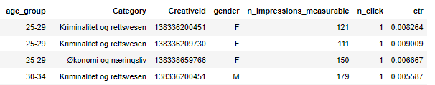
The Dataset
Amedia
685553 observations
19 features
Behavioral
Categorical
Notes:
The dataset containted both categorical and behavioral data
This leads to the exploratory data analysis to make more sense of the data

Slide 7

Exploratory Data Analysis

Slide 8
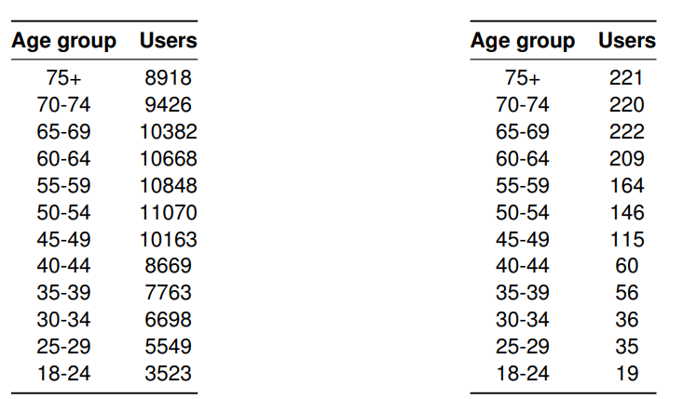
Exploratory Data Analysis
680 000 → 100 000
100 000 → 700
Statistical robustness
Treshold
Not Clicked
Clicked
→

Slide 9
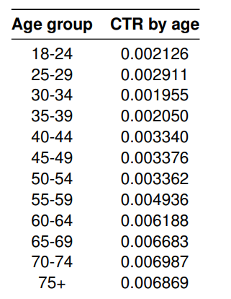
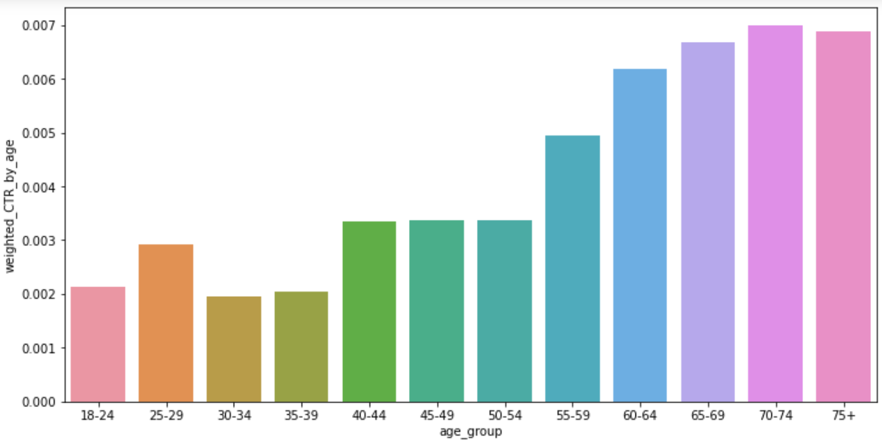
Exploratory Data Analysis
Click Through Rate
Young vs Elder

Slide 10
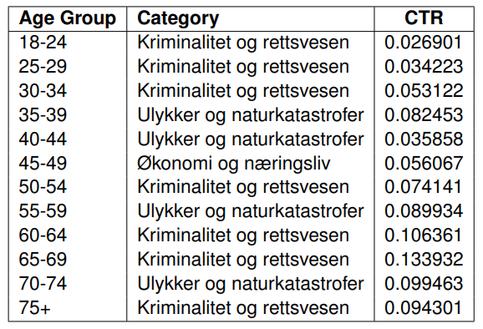
Exploratory Data Analysis
Most popular category
Why do they click?
Notes:
The main question is, what makes people click advertisements? Next slide

Slide 11
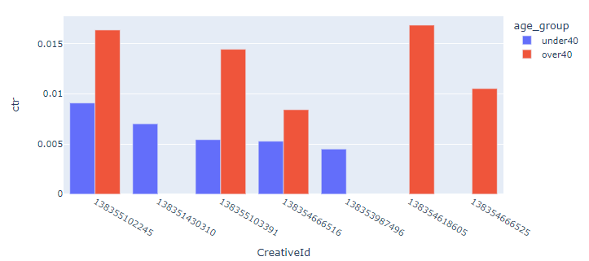
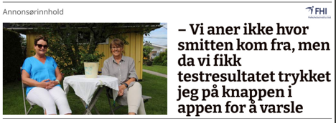
Exploratory Data Analysis
Confusion
Advertisements or article?
Worried
Fear
Sickness
Notes:
Can it be factors such as people are confused by differantiating the article or the advertisement, or could it be the text?
Can emotions and objects play a major role in whether people click or not?

Slide 12
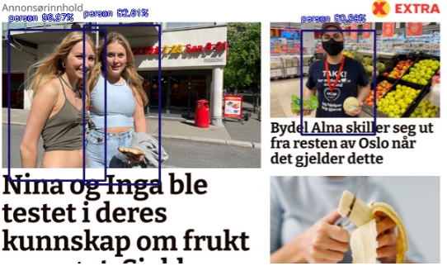
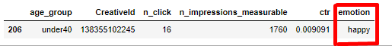
Exploratory Data Analysis
Influencing Factors
Emotions
Objects
Notes:
This further leads to the object and emotion detection performed

Slide 13
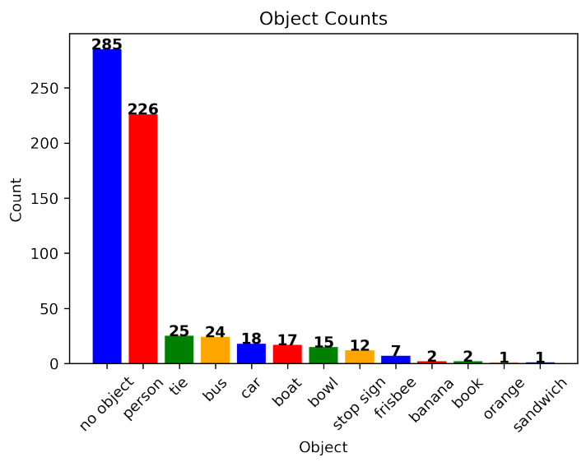
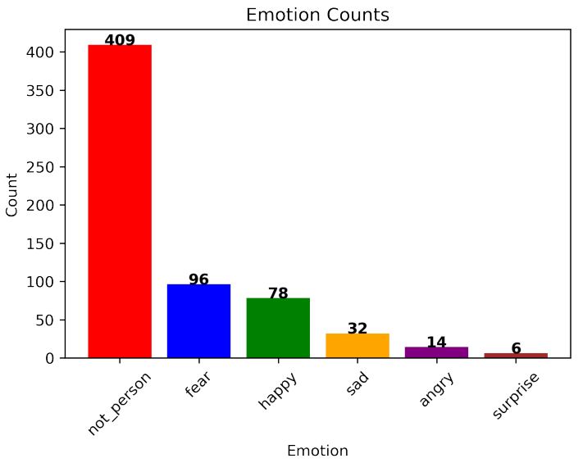
Feature Extraction
Objects and Emotions
Expanding dataset

Slide 14
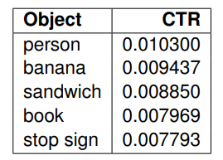
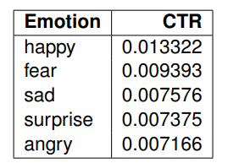
Feature Extraction
Click Behavior

Slide 15
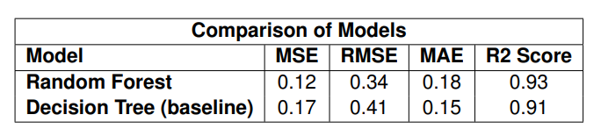
Predictive models
Imbalanced dataset
Random Forest
Decision Tree
The dataset
Notes:
Due to imbalanced nature number of clicks used, since it is relevant for the media industry
Required robust techniques to handle variations
These scores indicate that both models performed well in predicting the number of clicks. However, the Random Forest model exhibited slightly superior performance, as reflected by its lower error values and higher R2 score.
What i wanted to do further with this predictive model, was to compute the feature importance each feature had to predict the number of clicks
The low values of MSE, RMSE, and MAE indicate that the model's predictions were close to the actual values, while the high R2 score indicates a strong correlation between the predicted and actual values.

Slide 16
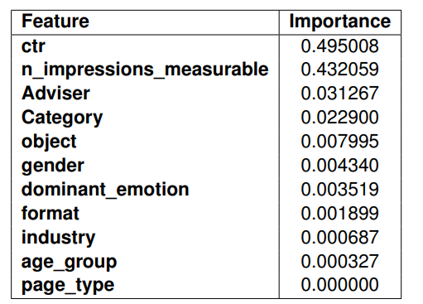
Predictive models
Feature Importance
Visibile advertisements

Slide 17
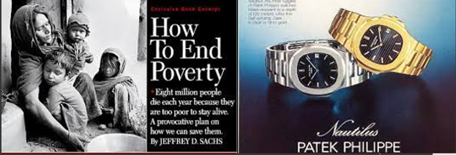
Notes:
This further leads to the user study conducted in this master thesis

Slide 18
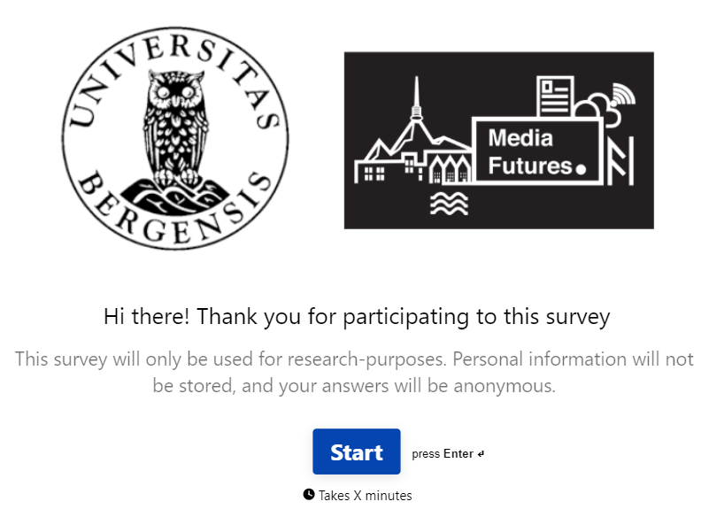
User-Study
Typeform & Prolific
Qualitative and Quantitative
67 Participants
Notes:
54 engaged through the crowdsourcing platform Prolific, where each participant were monetarily payed for their constribution to the study
13 were voluntary

Slide 19
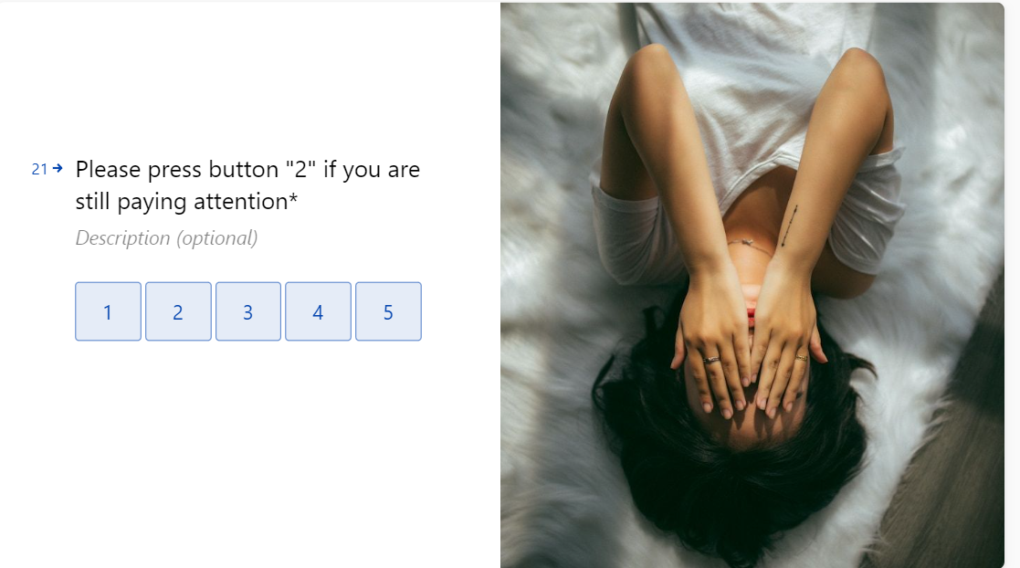
Instructional Manipulation Check
Notes:
Ive included a IMU, in order to filter out people who dont pay attention, or lets say bots

Slide 20
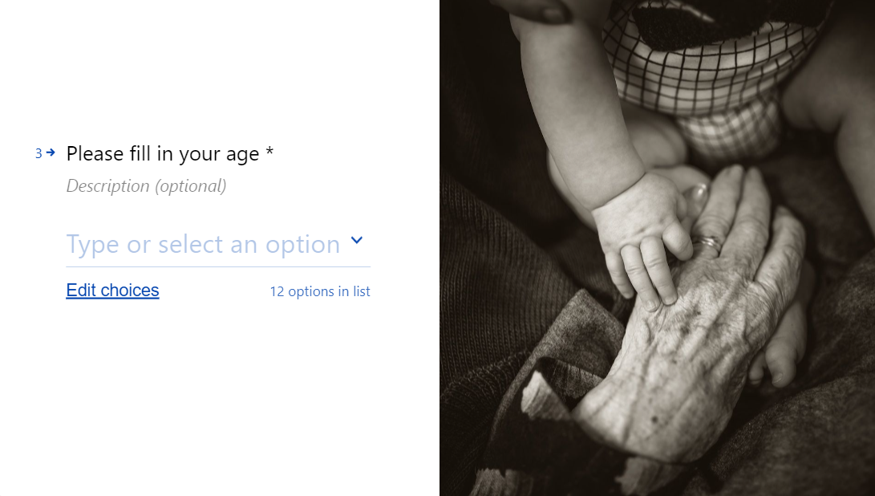
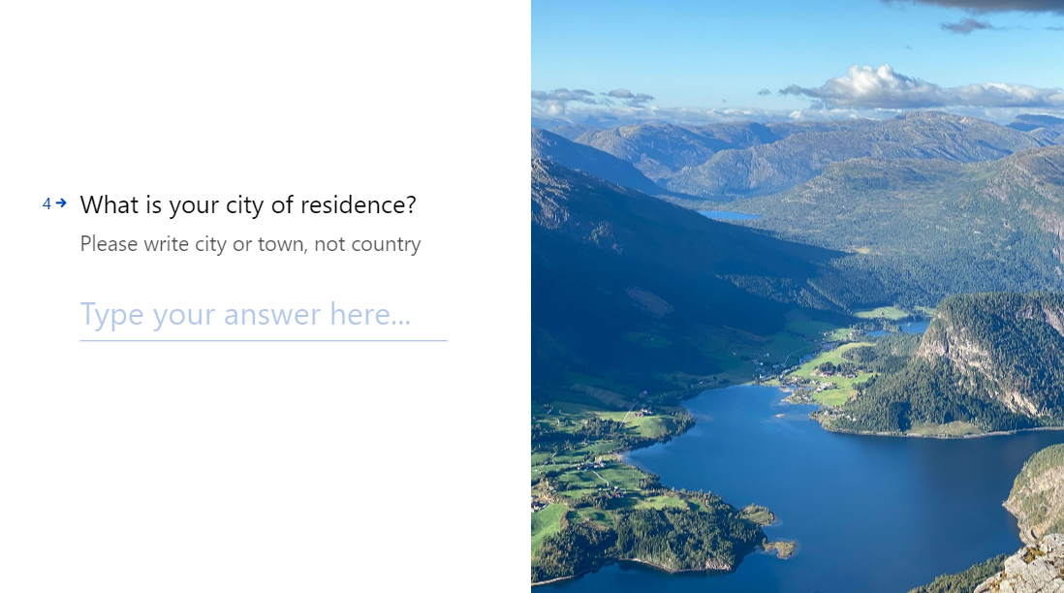
User Study
Notes:
In order to evaluate different users, ive made them fill in their age, and it is also interesting to see their geographical residence, in order to see if there are any differences in terms of what type of ads they like

Slide 21
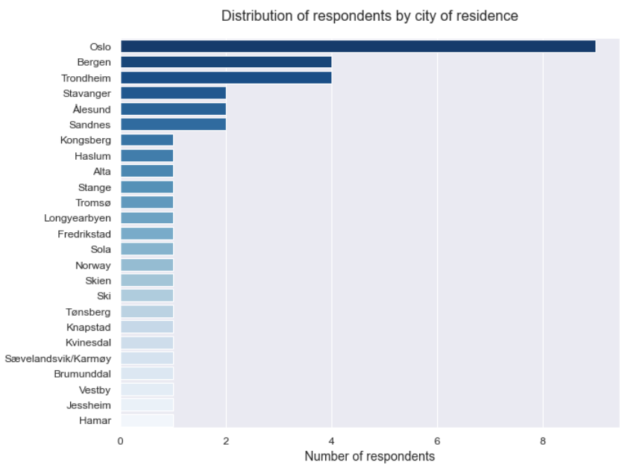
Notes:
Participants from all over Norway
From Tønsberg in the South to Tromsø in the North

Slide 22
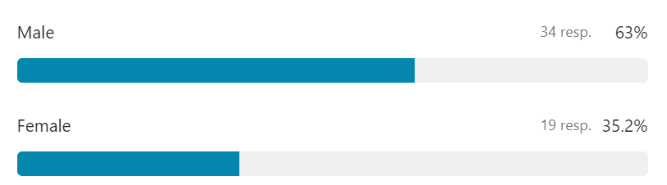
User Study Results - Participants

Slide 23
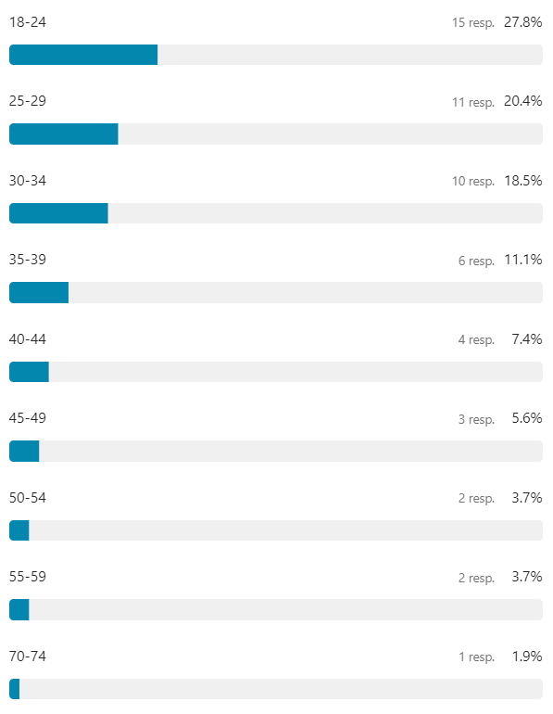
User Study Results - Participants
Notes:
Further on what i’ve seen is that most of the participants are men

Slide 24
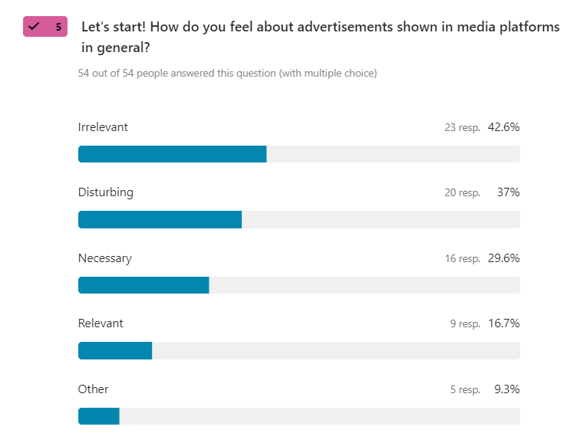
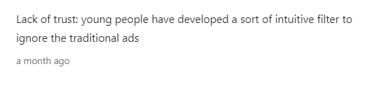
User Study Results
Necessary
Irrelevant
«Lack of trust»
Notes:
Mostly all people find the ads today irrelvant, and also ive left in the opportunity to leave in own opinions such as the other option, and there was one participant mention that young people have developed a sort of intui9tive filter to ignore traditional ads
This is somehow what i am trying to address

Slide 25
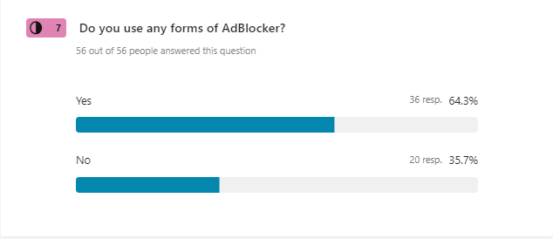
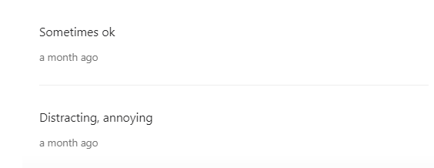
User Study Results
Notes:
Gambling addict
Illustrates the bias of advertisement

Slide 26
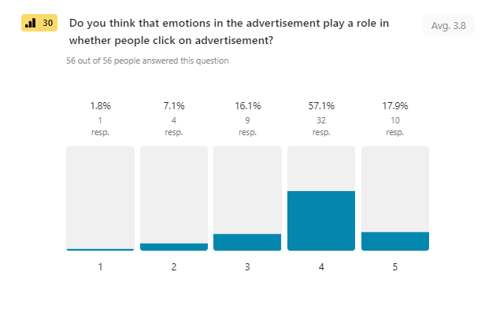
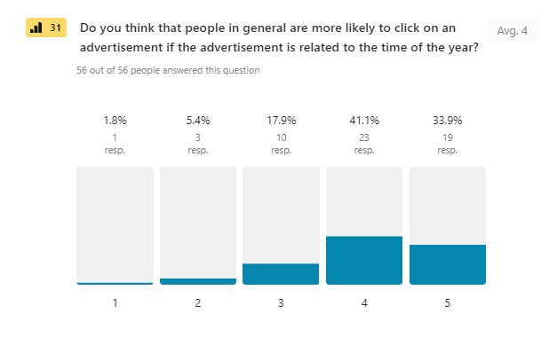
Results – Opinion Scales

Slide 27
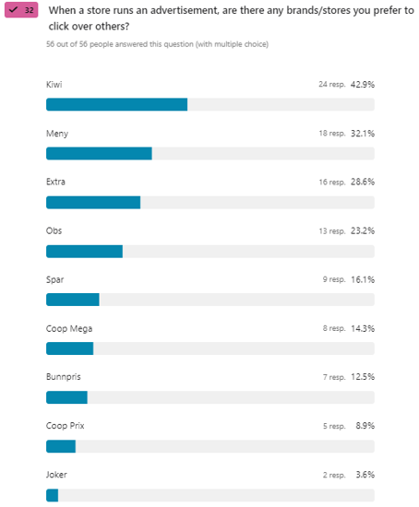
User Study Results
Kiwi and Meny
Notes:
So, why did i collect information about people preferences as well as information about themselves? Because i wanted to dig into the differences between ages and genders (NEXT SLIDE)

Slide 28
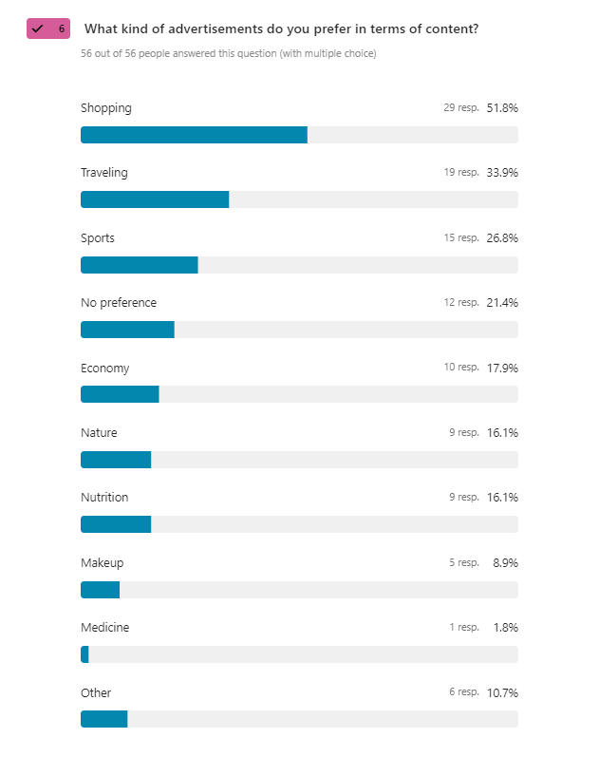
User Study Results
Shopping and Traveling
Notes:
So, why did i collect information about people preferences as well as information about themselves? Because i wanted to dig into the differences between ages and genders (NEXT SLIDE)

Slide 29
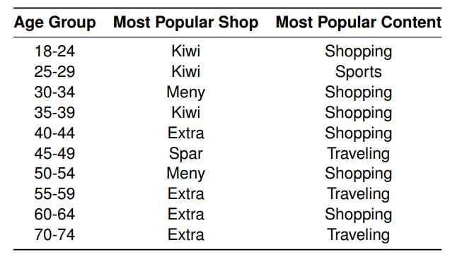
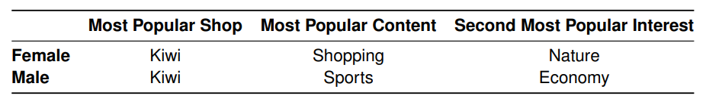
User Study Results
Business Value
Notes:
Mostly all people find the ads today irrelvant, and also ive left in the opportunity to leave in own opinions such as the other option, and there was one participant mention that young people have developed a sort of intui9tive filter to ignore traditional ads
This is somehow what i am trying to address

Slide 30
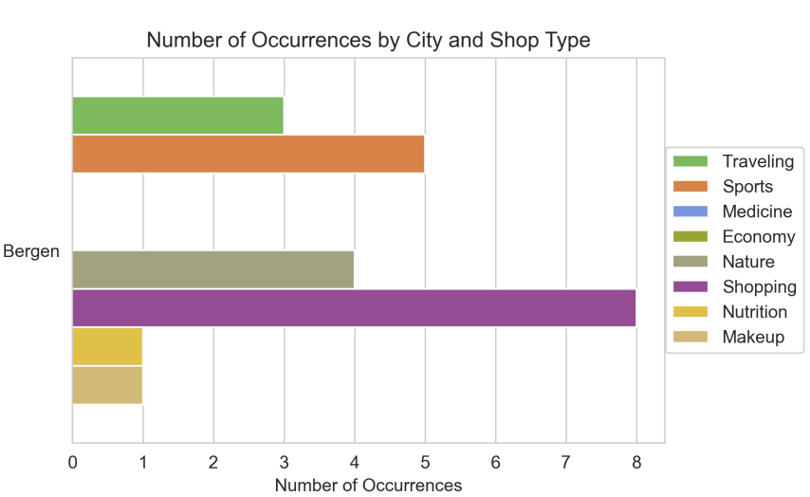
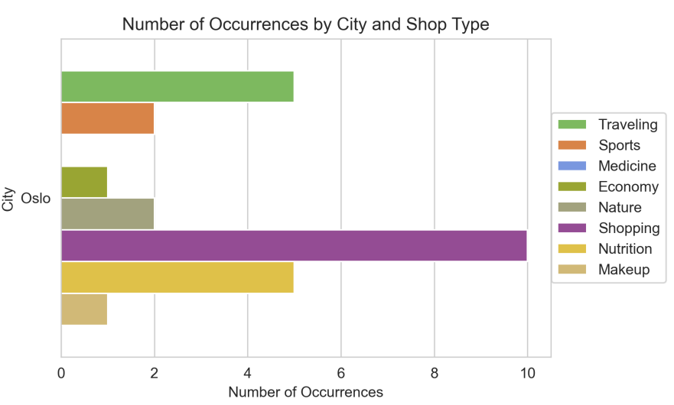
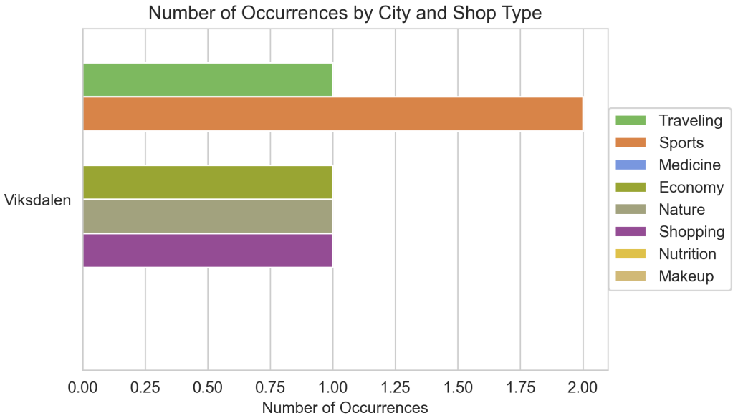
User Study Results
Demographic Factors

Slide 31
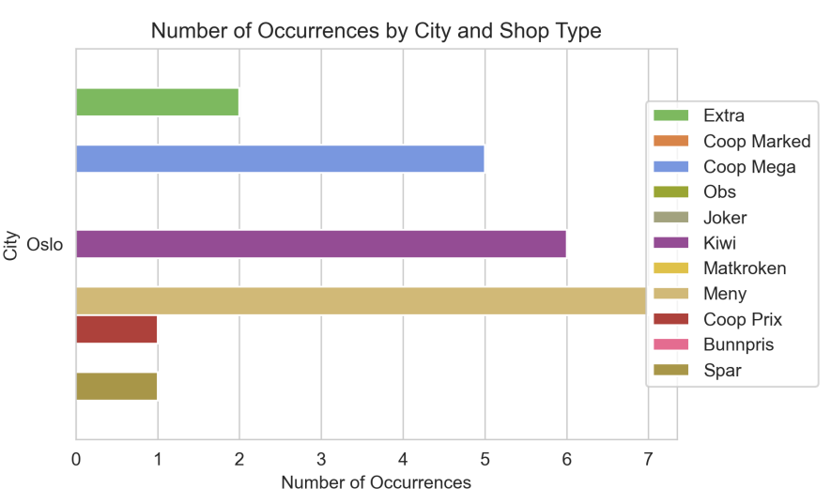
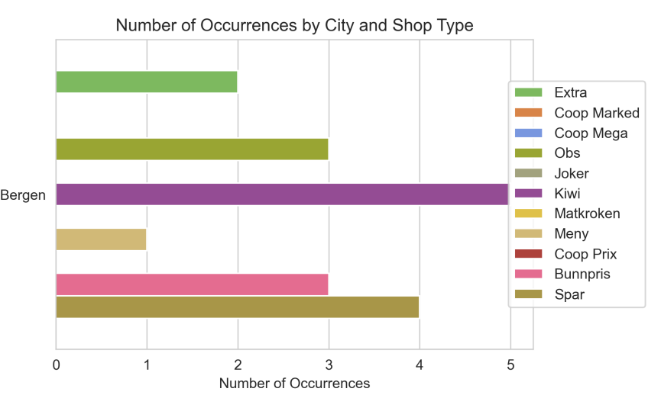
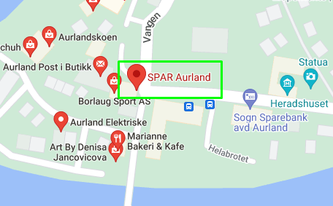
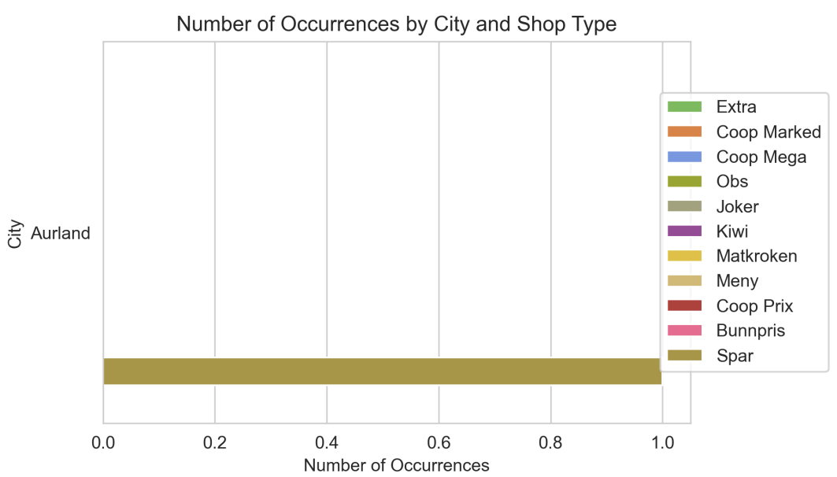
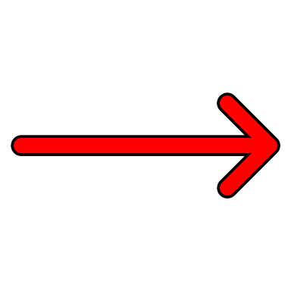
User Study Results

Slide 32
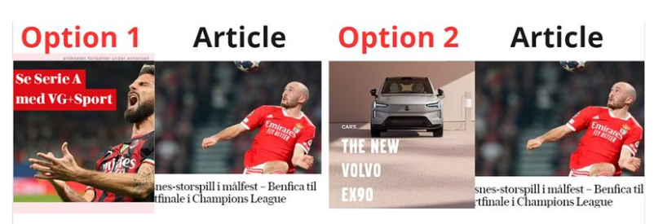
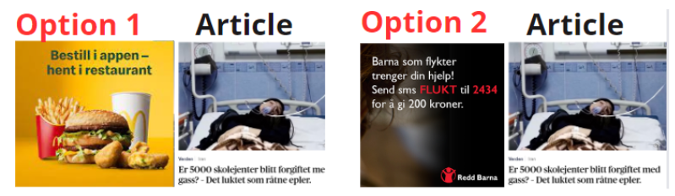
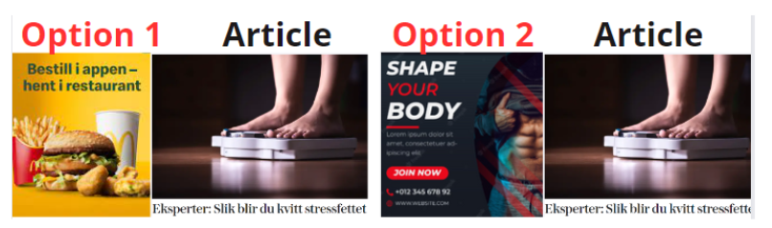
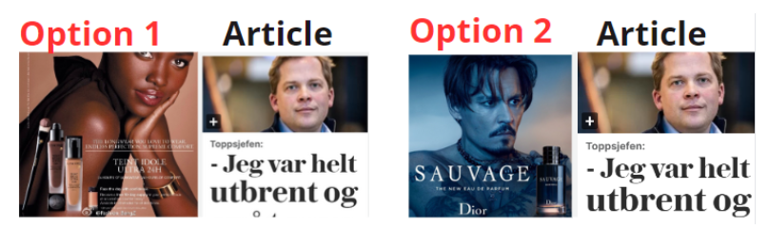
User Study - Examples
Notes:
So what i’ve done is that i’ve constructed 4 different examples where i show the same advertisement next to differnt articles in different contexts

Slide 33
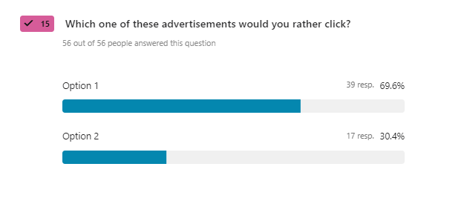
User Study
Notes:
So what i’ve done is that i’ve constructed 4 different examples where i show the same advertisement next to differnt articles in different contexts

Slide 34
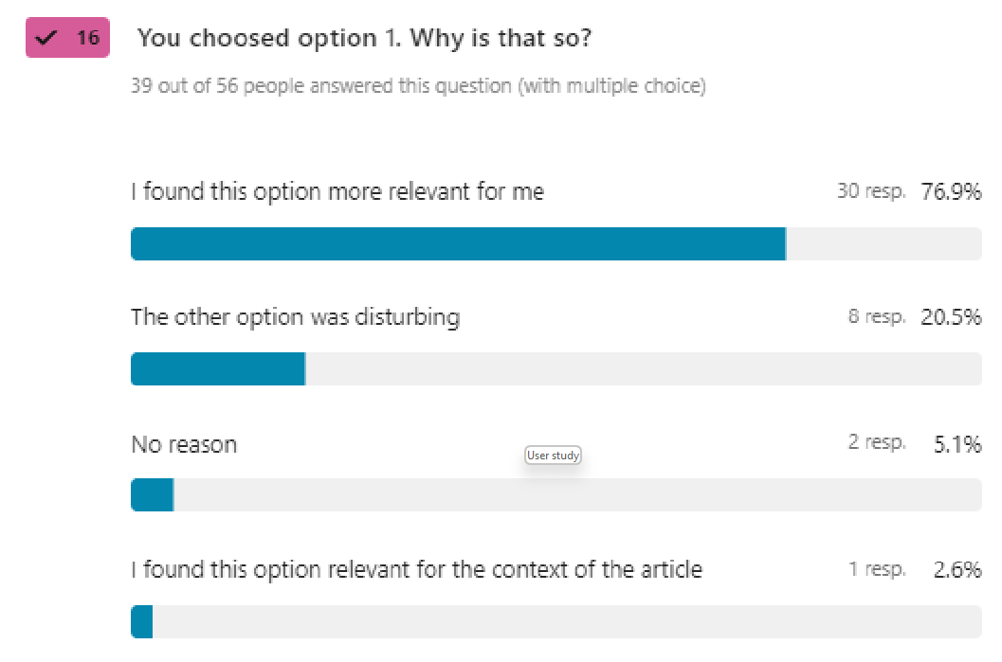
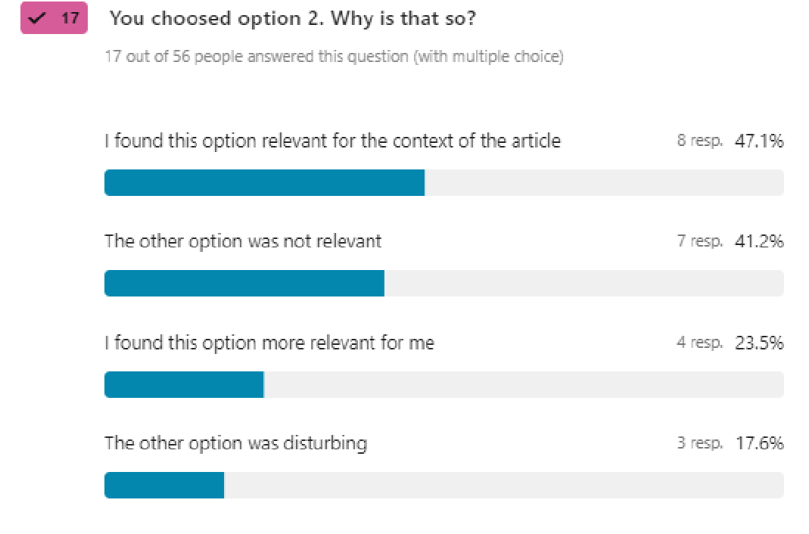
User Study
Contextualized
Disturbing
Personalized
Notes:
So what i’ve done is that i’ve constructed 4 different examples where i show the same advertisement next to differnt articles in different contexts

Slide 35
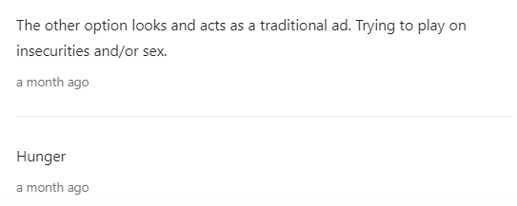
User Study
Time of day
Insecurity
Hunger
Notes:
So what i’ve done is that i’ve constructed 4 different examples where i show the same advertisement next to differnt articles in different contexts

Slide 36
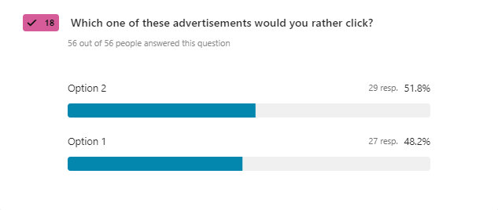
User Study
Notes:
So what i’ve done is that i’ve constructed 4 different examples where i show the same advertisement next to differnt articles in different contexts

Slide 37




User Study
Personalized
Notes:
So what i’ve done is that i’ve constructed 4 different examples where i show the same advertisement next to differnt articles in different contexts

Slide 38

User Study
Notes:
So what i’ve done is that i’ve constructed 4 different examples where i show the same advertisement next to differnt articles in different contexts

Slide 39


User Study
Relevance
Context
Ethics?
Notes:
So what i’ve done is that i’ve constructed 4 different examples where i show the same advertisement next to differnt articles in different contexts

Slide 40

User Study
Notes:
So what i’ve done is that i’ve constructed 4 different examples where i show the same advertisement next to differnt articles in different contexts

Slide 41


User Study
Gender stereotypes
Notes:
So what i’ve done is that i’ve constructed 4 different examples where i show the same advertisement next to differnt articles in different contexts

Slide 42

User Study
Personal preferences
Notes:
So what i’ve done is that i’ve constructed 4 different examples where i show the same advertisement next to differnt articles in different contexts

Slide 43

What i’ve learned
Media Industry
User Behavior
Demographic and personality factors
Communication and attention
Notes:
Fiks syntax

Slide 44

Conclusion
Important industry
Young and elder people
The actual context
Ethical considerations
Notes:
Fiks syntax

Slide 45
Frank Rune Espeseth
fes010@uib.no

